Slide 1


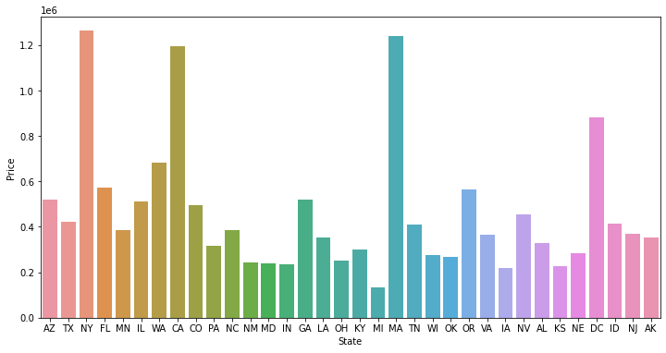
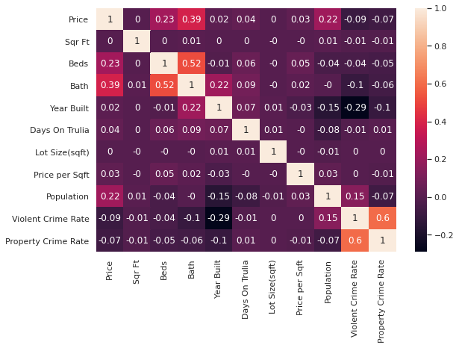
Real Estate Listings Price Prediction
Kelsey Dinndorf | Data Science Senior Project | January 26, 2021
Introduction
Hypotheses/Questions
Results
Motivation: There is a lot of variation in the prices of real estate, and it is often difficult to know whether or not you are paying a fair price for a house. It is challenging for people to know if the real estate price listed online truly reflects the value of the house, especially for people who do not know much about real estate. This uncertainty is even more frustrating for people looking for a house during the pandemic. I am interested in uncovering the factors that contribute most to the price of a house and how that price is determined. I aim to help inform people more about what determines the prices of real estate.
Goal: Implement a Multiple Linear Regression Model to predict price and determine which factors are most significant in deciding the price of a house.
Larger houses with larger lot sizes are more expensive.
Houses with more features (bedrooms, bathrooms, etc.) are more expensive.
Cities that have higher crime have lower real estate prices.
Do newer or older houses tend to cost more?
How does the location of the house (city/state) play a role in the price?
Final Linear Regression Model in Python
Year Built, City, Log(Bathrooms), Log(SqrFt), and Log(Lot Size)
Adjusted R-squared: 0.518. These variables explain about 52% of the variation in Log(Price).
Test Set Mean Squared Error: 0.0037
Final Linear Regression Model in R
Year Built, Log(Bathrooms), Log(Bedrooms), Log(Size), Log(Lot Size), City, and 3 interactions: Log(Bathrooms) with Log(Size), Log(Bedrooms) with Log(Size), and Year Built with Log(Size)
Adjusted R-squared: 0.569. These variables explain about 57% of the variation in Log(Price).
Number of Bedrooms is not very significant in the model on its own, but the interaction between bedrooms and size is very significant.
The average deviation in actual vs predicted values is about 5%, which is not bad.
As lot size increases by 1%, price increases by about 3.56%.
Tree Regression Model
R-squared: 0.51
Adding city to the models increased the R-squared a lot, so city is very significant.
Model in R using interactions and step-wise regression (BIC) gave the best results for predicting Price.
Data
Real Estate Data:
Pre-processed data found on Kaggle’s website
Scraped from Trulia, a subsidiary of Zillow, in 2019
Contains various real estate listings from multiple cities/states in the United States
68 attributes including price, size, location, style, year built, features, years listed on Trulia, and more
30,000 records
Crime Data:
Obtained from the FBI Uniform Crime Reporting (UCR) Program
Includes the total number of known violent crimes and property crimes for each city in 2019
Exploratory Data Analysis:
Real Estate and Crime data were merged
Feature Construction/Removed insignificant attributes
Replaced missing data with mean/median
Removed outliers with Z-score
Graphs: Bar charts, Histograms, Scatter plots, Boxplots
Correlation Matrix
Models
Used variables most correlated with Price as predictors
1-hot encoded categorical attributes (state and city)
Normalized the numeric data (feature scale)
Log-transformed variables due to right skew (Price, Bathrooms, Bedrooms, Size(sqft), Lot Size
Single and Multiple Linear Regression in Python:
Model Training:
Split data into training (80%) and test sets (20%)
Cross Validation – not as good
Accuracy evaluation: R-squared, MSE, MAE
Ran multiple models with various predictor variables.
Ran Final Model for only state of California
Multiple Linear Regression in R:
Step-wise Regression (removes not significant predictors) with AIC and BIC (stricter) criterion
Model with centered interactions among predictor variables
Residual Analysis
Tree Regression in R:
Ran model with significant predictors obtained from Final linear regression model in R
Conclusions
The number of bathrooms and the city are the most significant predictors of the price of real estate.
Violent and Property Crime Rates are not good predictors of the price of real estate.
Location plays a huge role in determining the price of real estate, especially specific cities.
Newer, larger real estate properties with more features tend to be more expensive.
Since the predictor variables only explain about 60% of the variation in price in my model, there is room for improvement. There are most likely other variables that contribute to the price of a house that are not included in my model like proximity to schools or shopping, other features of the property/house, property taxes, etc.
https://www.kaggle.com/promptcloud/real-estate-data-from-trulia
https://ucr.fbi.gov/crime-in-the-u.s/2019/crime-in-the-u.s.-2019/tables/table-8/table-8-data-declaration

